Slide 1
Post-Hoc Testing

Slide 2
The Puppy Example
No Puppy | 15-Minutes | 30-Minutes
3 | 5 | 7
2 | 2 | 4
1 | 4 | 5
1 | 2 | 3
4 | 3 | 6
M = 2.20 | M = 3.2 | M = 5
F = 5.37
df_{W} = 12
df_{B} = 2
MS_{B} = 10.57
MS_{W} = 1.967

Slide 3
Follow-up/Post-hoc Tests
The F-statistic tells us only that the experiment was successful
  i.e. group means were different
It does not tell us specifically which group means differ from which.
We need additional tests to find out where the group differences lie.

Slide 4
How?
Orthogonal Contrasts/Comparisons
  Hypothesis driven
  Planned a priori
Post hoc Tests
  Not Planned (no hypothesis)
  Compare all pairs of means (separate t-tests, usually corrected for inflated type I error)

Slide 5
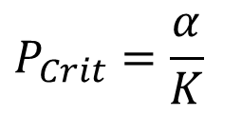
Post Hoc Tests
Compare each mean against all others.
In general terms, they use a stricter criterion to accept an effect as significant.
  Hence, control the family-wise error rate.
  Simplest example is the Bonferroni method:
$$P_{Crit}=\frac{α}{K}$$
In our example, we could conduct Bonferronni corrected t-tests for each comparison (3 t-tests ttotal!)

Slide 6

Tukey’s HSD (1)
The most common post-hoc test is Tukey’s HSD (Honestly Significant Difference)
n = sample size per group
Only works if each sample has the same size (equal n).
$$HSD=q\sqrt{\frac{{MS}_{error}}{n}}$$
Note: Use MS_{W} for independent designs and MS_{R} for repeated measures!

Slide 7


Tukey’s HSD (2)
$$HSD=q\sqrt{\frac{{MS}_{w}}{n}}$$
$$HSD=q\sqrt{\frac{1.967}{5}}$$

Slide 8
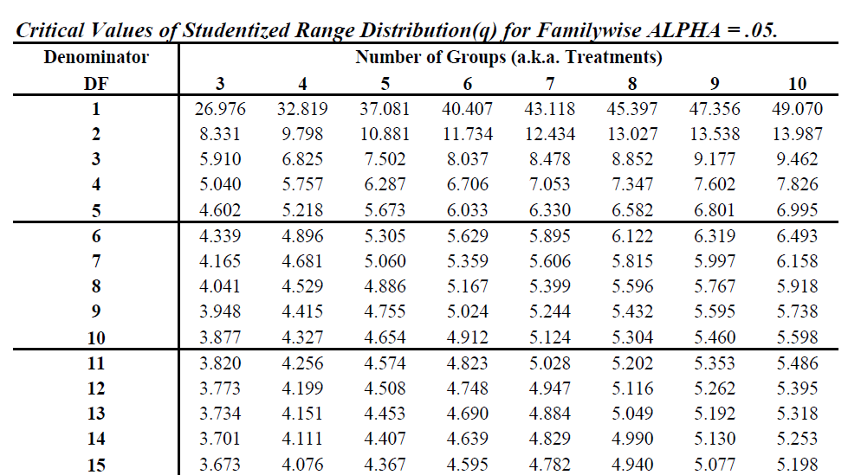
q-table
Note: Use df_{W} for independent designs and df_{R} for repeated measures!

Slide 9
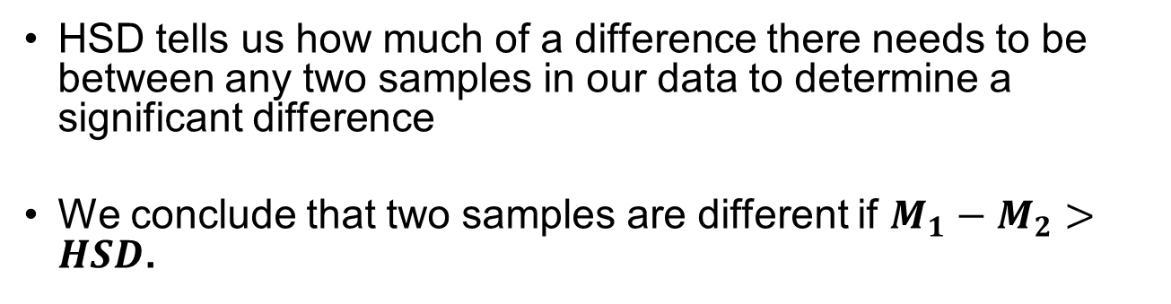
Interpreting Tukey’s HSD
HSD tells us how much of a difference there needs to be between any two samples in our data to determine a significant difference
We conclude that two samples are different if $M_{1}−M_{2}>HSD$.

Slide 10


Tukey’s HSD (2)
$$HSD=3.773\sqrt{\frac{1.967}{5}}$$
$$HSD=3.773\sqrt{\frac{1.967}{5}}$$
$$HSD=3.773 ∗ .627$$
$$HSD=2.37$$

Slide 11
Tukey’s HSD (3)
Now that we have HSD, we can test for significant differences between groups
Steps:
  Take the difference between groups.
  Compare to HSD
  If diff > HSD, you have a significant difference

Slide 12
The Puppy Example (2)
No Puppy | 15-Minutes | 30-Minutes
3 | 5 | 7
2 | 2 | 4
1 | 4 | 5
1 | 2 | 3
4 | 3 | 6
M = 2.20 | M = 3.2 | M = 5
HSD = 2.37
Group 1 vs 2: 3.2 – 2.2 = 1 (Non-sig!)
Group 2 vs 3: 5 – 3.2 = 1.8 (Non-sig!)
Group 1 vs 3: 5 – 2.20 = 2.8 (Significant!)

